Slide 1
Lecture 14:
Hash Table
Keren Zhu
kerenzhu@cse.cuhk.edu.hk

Slide 2
Announcement
We will have Course and Teaching Evaluation tomorrow
  I believe you will receive a link to the questionaries so it can be due remotely
  An assistant will come to the lecture tomorrow to help you do it in person
HW 6 is out
  It is due March 29 (Friday).
  I was planning to make it due Tuesday. But in case we cannot finish everything due to CTE, let give it more time.
  I still plan to have a new homework set posted next week
  We are set to have in total 8 homeworks

Slide 3
Some points we have learned
Comparison-based sorting is general for ordered elements
But with better knowledge of the underlying key data, we can have better O(n) algorithms, like counting sort
We learned the data structures for set
  Ordered set can has better operations
  The data requires a comparison function
Can we have a “counting sort”-like idea to make sets more efficient?
  An “unordered” set
  Better dictionary search

Slide 4
A simple application example
Let’s say we can use ID as key and we want to have fast query operation
What if we use an unsorted array? Runtime complexity?
  O(n) find, O(1) insert, O(1) delete
Red-black tree?
  O(log n) find, O(log n) insert, O(log n) delete
ID | Name | HW1 | HW2 | HW3 | Quiz 1 | Midterm | PA1 zip
3324 | Bill | int | int | int | int | int | large binary
4352 | John | int | int | int | int | int | large binary
6323 | Alice | int | int | int | int | int | large binary
8542 | Jack | int | int | int | int | int | large binary
…

Slide 5
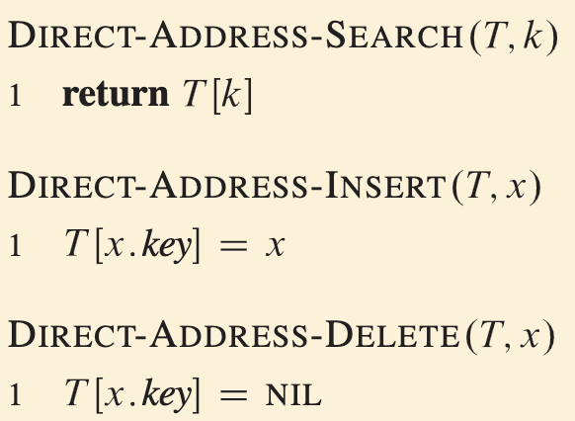
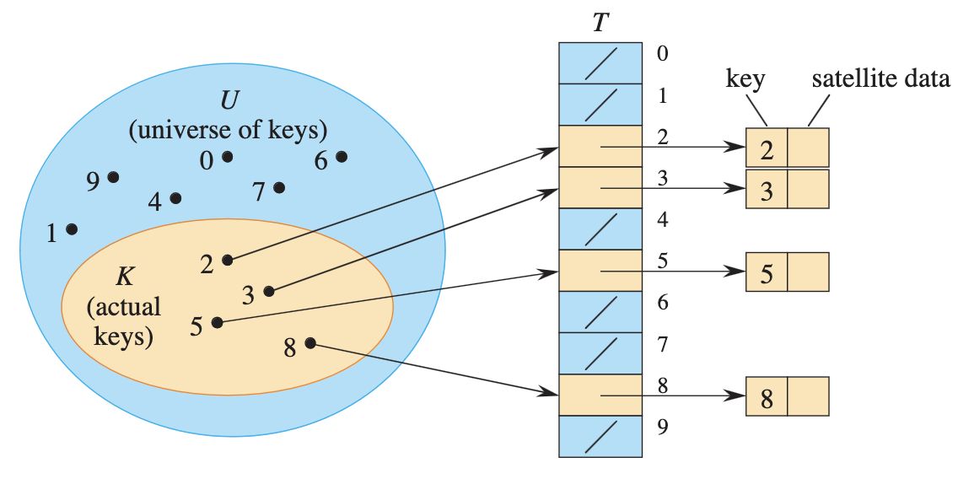

Unrealistic solution: direct-address tables
The elements has a distinct key drawn from the Universe $U=\{0, 1, …, m−1\}$, where m is not too large
We can create a direct-address table $T[0:m−1]$, in which each position, or slot, corresponds to a key in U

Slide 6
A large array for students
Let’s just create a large array
O(1) search, O(1) insert, O(1) delete
Problem?
  Memory
  Suppose ID is possibly 1-1M, we need to allocate an array of 1M size
Key | Value
… | nullptr
3324 | *Student(bill)
… | nullptr
4352 | *Student(john)
… | nullptr
6323 | *Student(Alice)
…

Slide 7
Construct a simple LUT
But we know 100 students enrolled, and this function is not change
If we want to search 3324, O(1) to find the index, O(1) to query the value
ID | hash(ID)
3324 | 1
4352 | 2
6323 | 3
8542 | 4
index | Value
1 | *Student(bill)
2 | *Student(john)
3 | *Student(Alice)
4 | *Student(Jack)

Slide 8

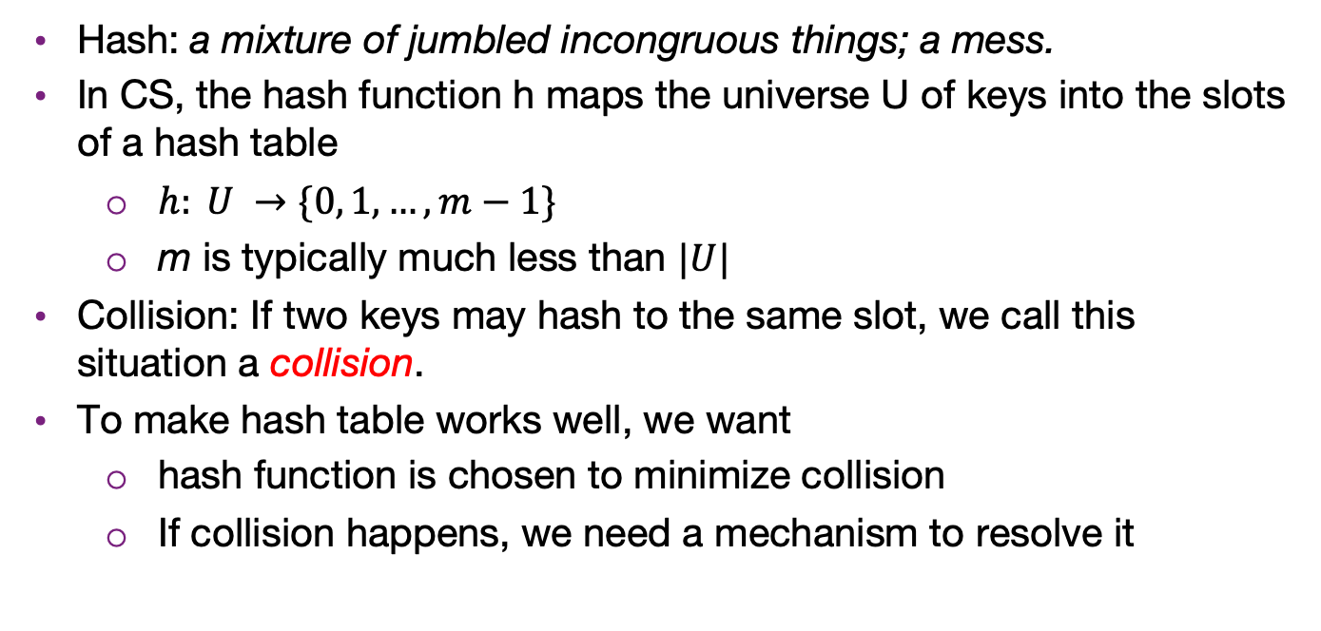
Hash function
Hash: a mixture of jumbled incongruous things; a mess.
In CS, the hash function h maps the universe U of keys into the slots of a hash table
  $h: U →\{0, 1,…, m−1\}$
  m is typically much less than $|U|$
Collision: If two keys may hash to the same slot, we call this situation a collision.
To make hash table works well, we want
  hash function is chosen to minimize collision
  If collision happens, we need a mechanism to resolve it
Potato hash

Slide 9
The hash process
We will break the process into
three independent steps:
  We will try to get each of
  these down to Θ(1)
Object
Techniques vary...
32-bit integer
Modulus, mid-square,
multiplicative, Fibonacci
Map to an index 0, ..., M – 1
Deal with collisions
Chained hash tables
Open addressing
Linear probing
Quadratic probing
Double hashing

Slide 10
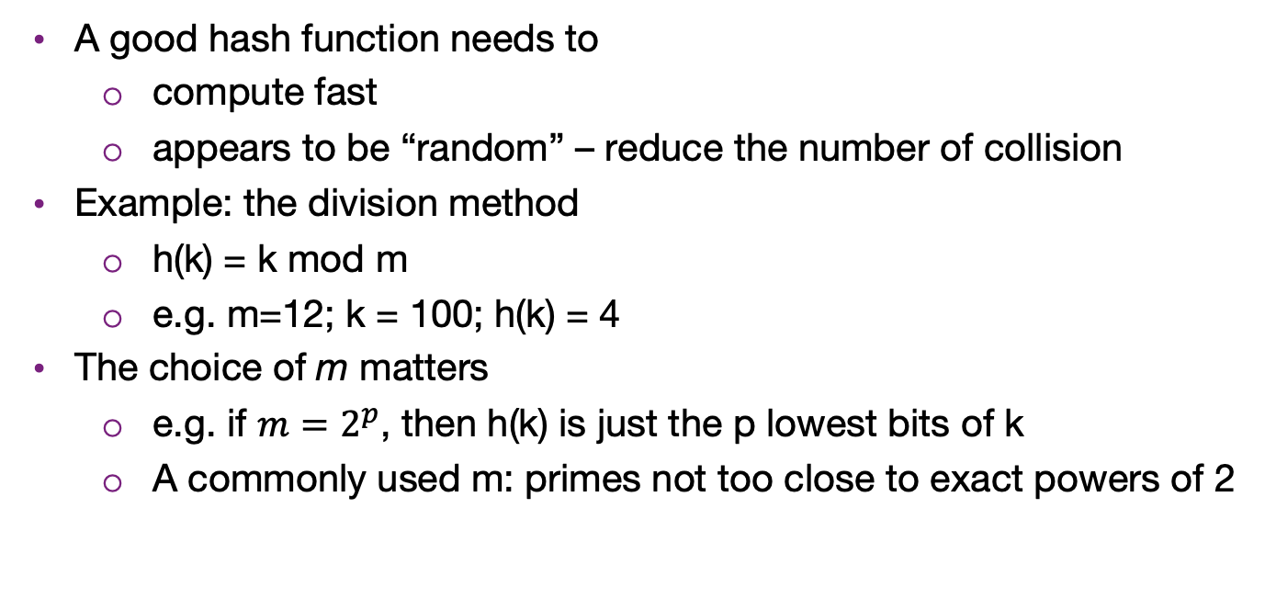
Hash function
A good hash function needs to
  compute fast
  appears to be “random” – reduce the number of collision
Example: the division method
  h(k) = k mod m
  e.g. m=12; k = 100; h(k) = 4
The choice of m matters
  e.g. if $m=2^{p}$, then h(k) is just the p lowest bits of k
  A commonly used m: primes not too close to exact powers of 2

Slide 11
Hashing a string
Let’s assume a string is an array of ASCII codes (8 bits, 0-127)
Method 1: sum of character ASCII codes
  Different permutations of the same set of characters would have the same hash value
  If the table size is large, the keys are not distribute well. e.g. Suppose m=10007 and all the keys are eight or fewer characters long. Since ASCII value <= 127, the hash function can only assume values between 0 and 127*8 = 1016

Slide 12
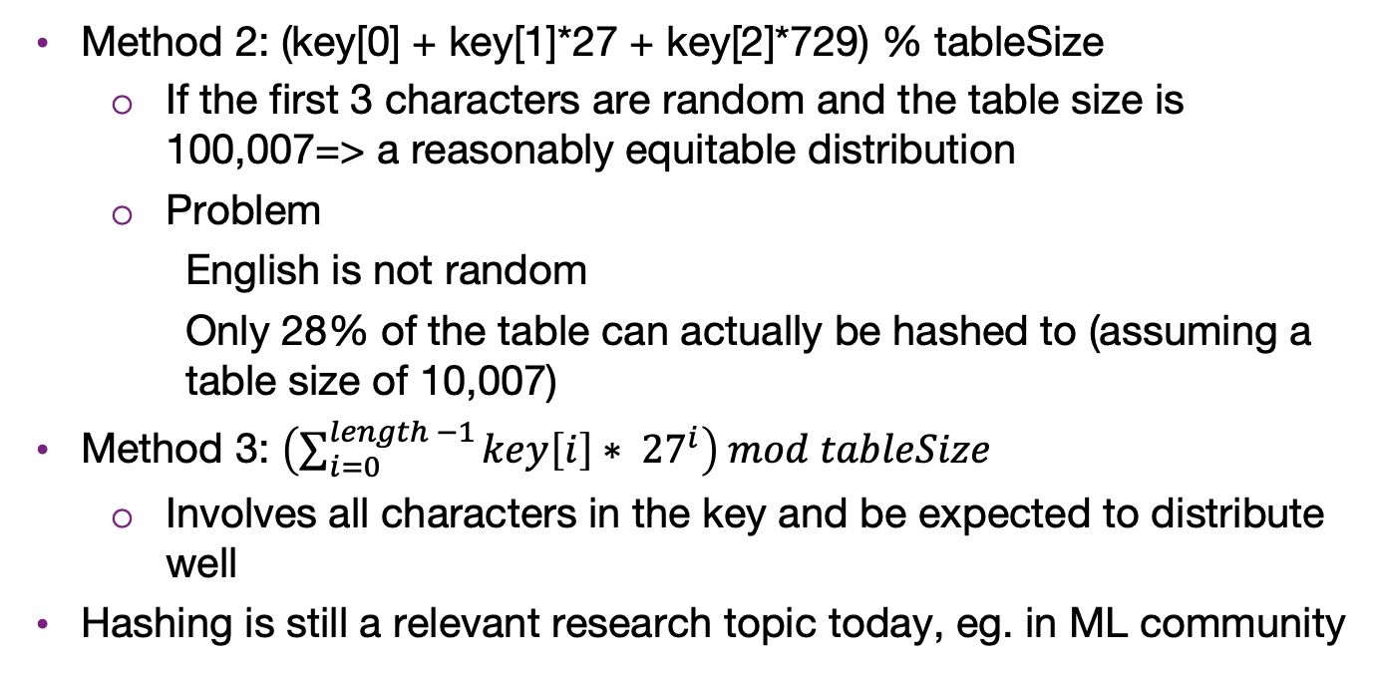
Hashing a string
Method 2: (key[0] + key[1]*27 + key[2]*729) % tableSize
  If the first 3 characters are random and the table size is 100,007=> a reasonably equitable distribution
  Problem
    English is not random
    Only 28% of the table can actually be hashed to (assuming a table size of 10,007)
Method 3: $\left(\sum_{i=0}^{length −1}{key\left[i\right]∗ {27}^{i}}\right) mod tableSize$
  Involves all characters in the key and be expected to distribute well
Hashing is still a relevant research topic today, eg. in ML community

Slide 13
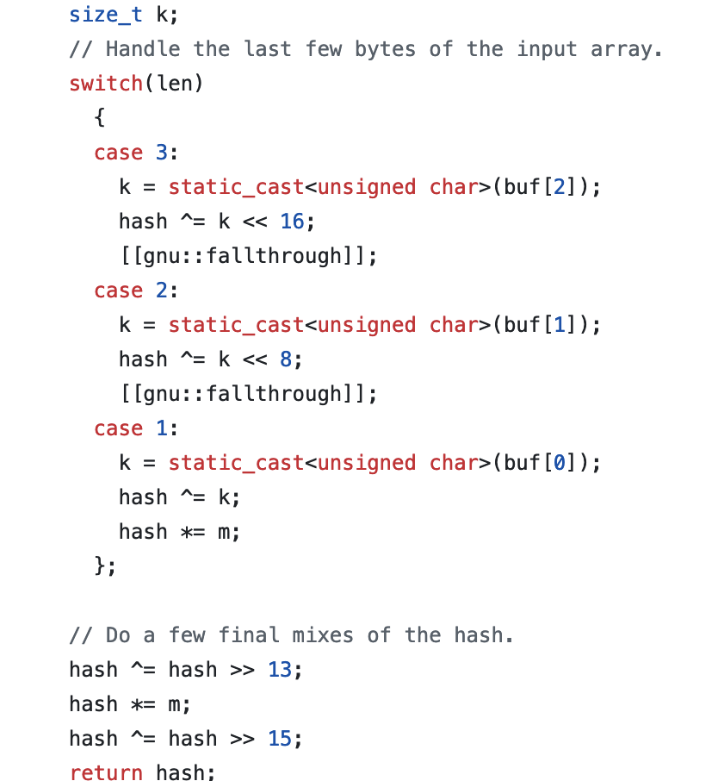
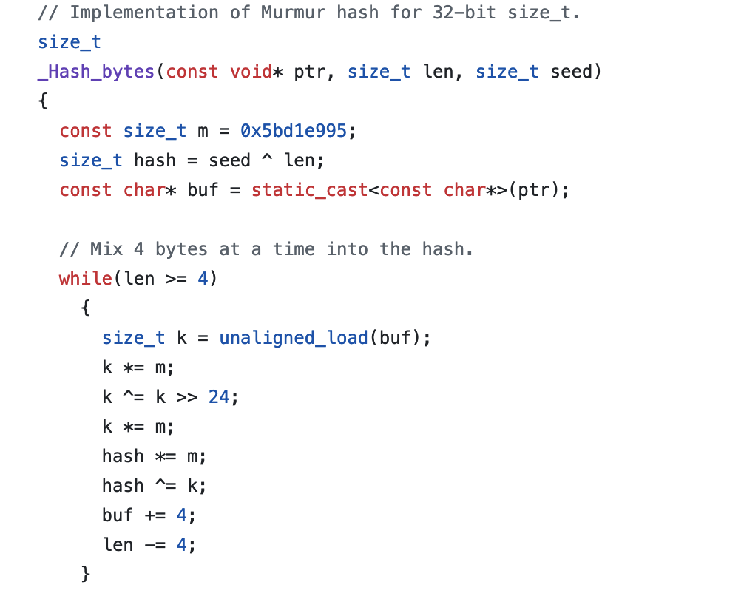
GCC hashing for string
In glibstdc+: https://gcc.gnu.org/git/?p=gcc.git;a=blob_plain;f=libstdc%2b%2b-v3/libsupc%2b%2b/hash_bytes.cc;hb=HEAD

Slide 14
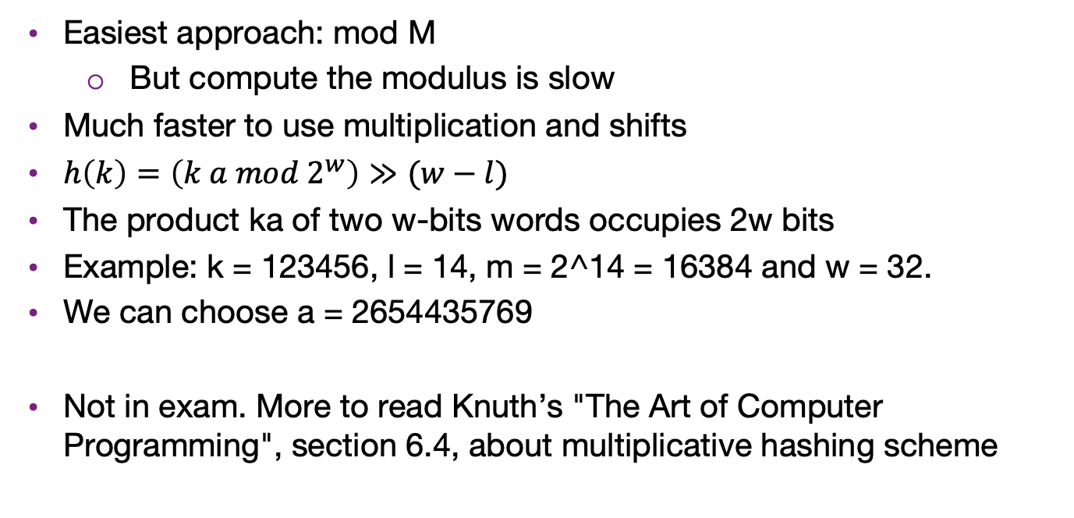
Map the hash value to 0…M-1
Easiest approach: mod M
  But compute the modulus is slow
Much faster to use multiplication and shifts
$h\left(k\right)=\left(k a mod 2^{w}\right)≫(w−l)$
The product ka of two w-bits words occupies 2w bits
Example: k = 123456, l = 14, m = 2^14 = 16384 and w = 32.
We can choose a = 2654435769
Not in exam. More to read Knuth’s "The Art of Computer Programming", section 6.4, about multiplicative hashing scheme

Slide 15
Dealing with collisions

Slide 16
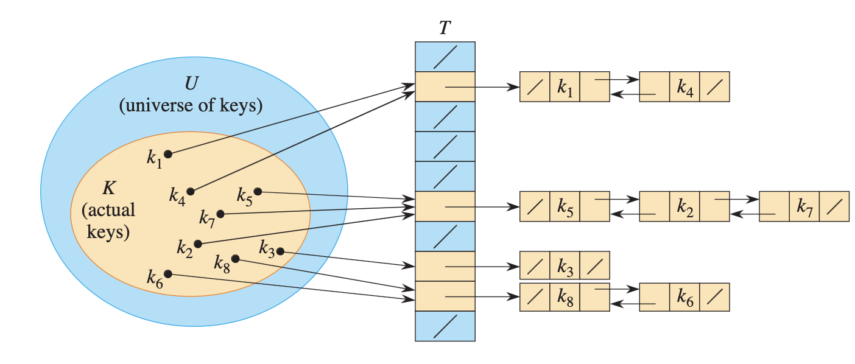
Separate chaining
Instead of a hash table, we use a table of linked list
Keep a linked list of keys that hash to the same value

Slide 17
Separate chaining
To insert a key k
  Compute h(k) to determine which list to traverse
  If T[h(K)] contains a null pointer, initialize this entry to point to a linked list that contains K alone.
  If T[h(K)] is a non-empty list, we add K at the beginning of this list (LIST-PREPEND).
To delete a key K
  compute h(K), then search for K within the list at T[h(K)]. Delete K if it is found. (LIST-DELETE).
The performance is heavily depends on the hashing function
  If the hashing function is so bad that mapping all the keys to the same slot, then it is basically a linked list

Slide 18
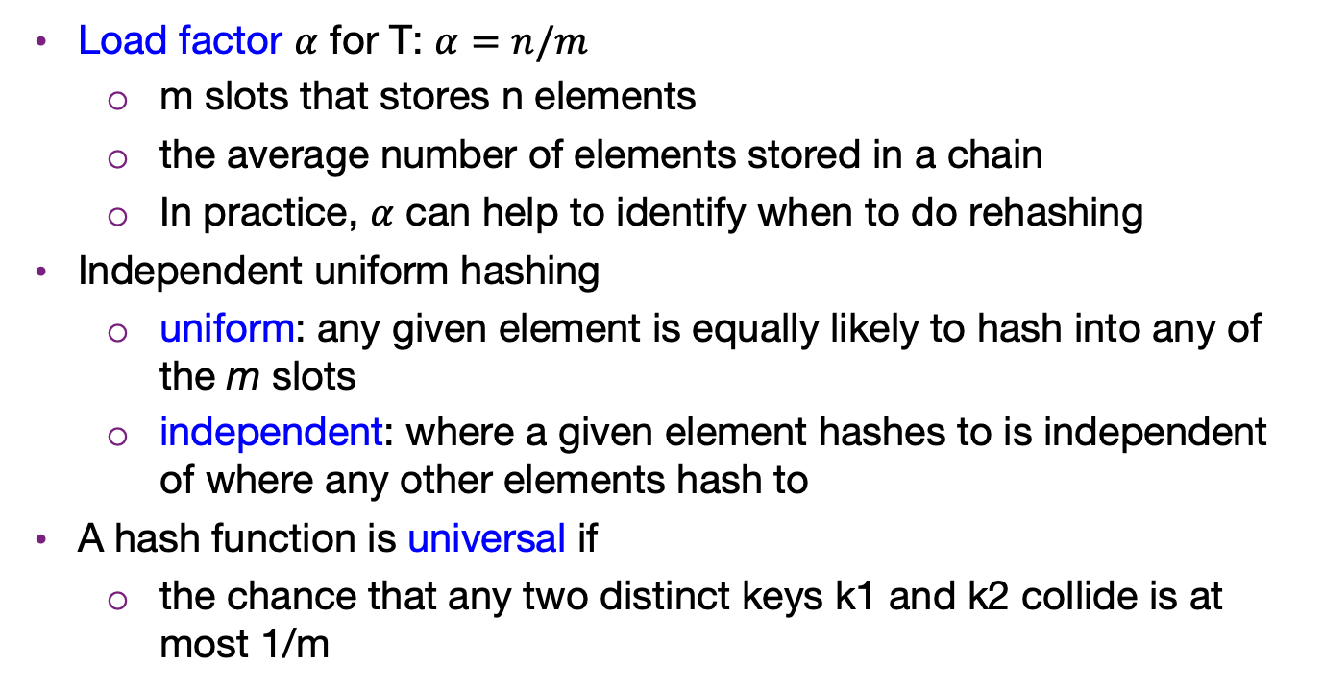
Analysis of separate chaining
Load factor $α$ for T: $α=n/m$
  m slots that stores n elements
  the average number of elements stored in a chain
  In practice, $α$ can help to identify when to do rehashing
Independent uniform hashing
  uniform: any given element is equally likely to hash into any of the m slots
  independent: where a given element hashes to is independent of where any other elements hash to
A hash function is universal if
  the chance that any two distinct keys k1 and k2 collide is at most 1/m

Slide 19
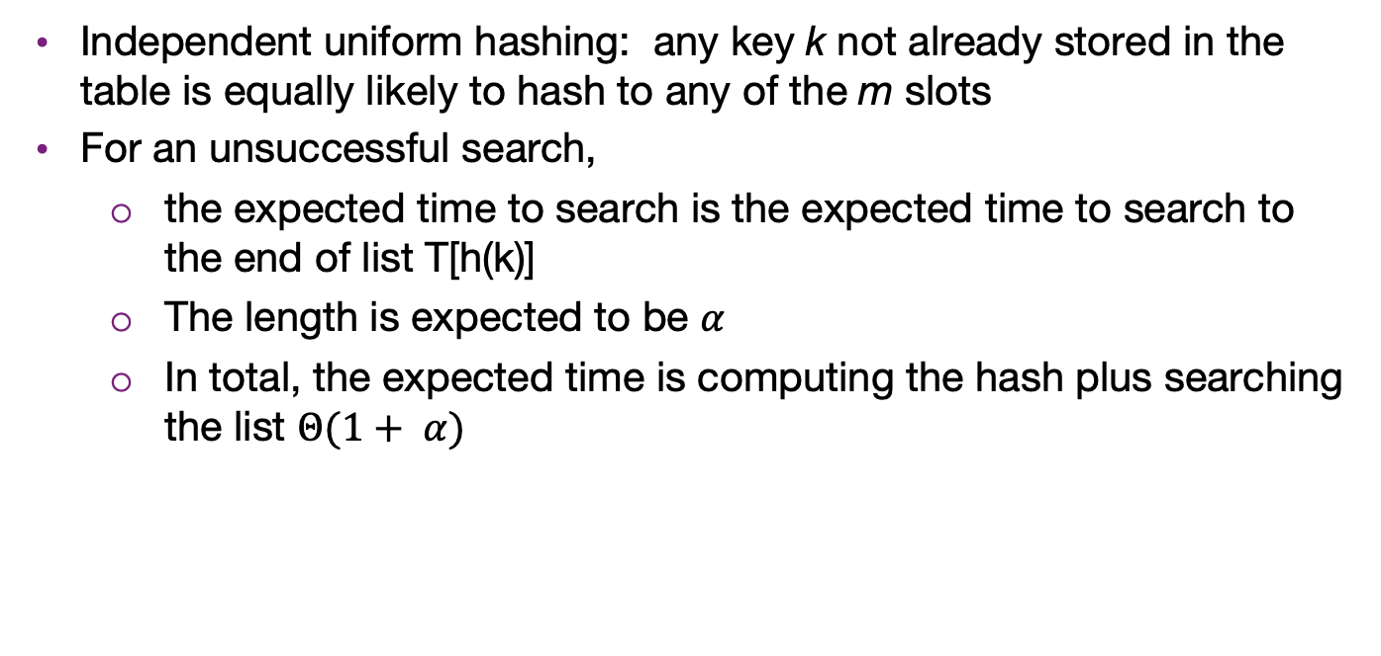
Analysis of separate chaining under universality
Independent uniform hashing: any key k not already stored in the table is equally likely to hash to any of the m slots
For an unsuccessful search,
  the expected time to search is the expected time to search to the end of list T[h(k)]
  The length is expected to be $α$
  In total, the expected time is computing the hash plus searching the list $Θ(1+ α)$

Slide 20
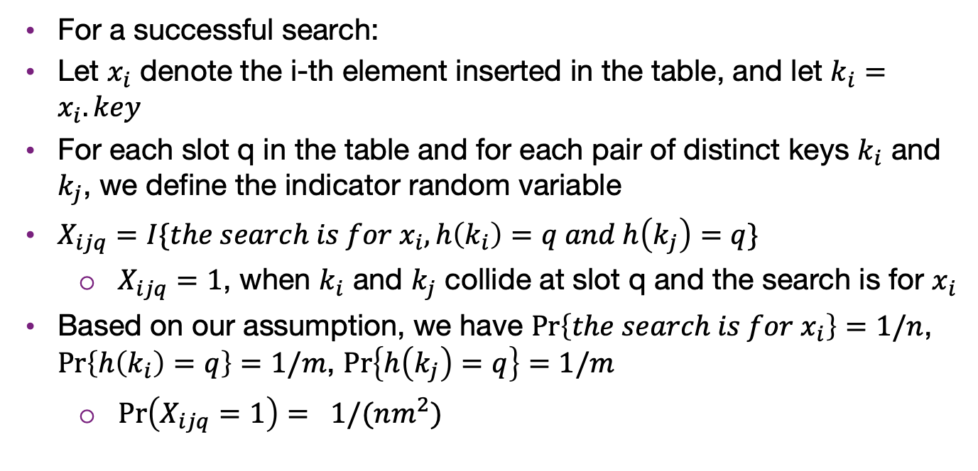
Analysis of separate chaining under universality
For a successful search:
Let $x_{i}$ denote the i-th element inserted in the table, and let $k_{i}=x_{i}.key$
For each slot q in the table and for each pair of distinct keys $k_{i}$ and $k_{j}$, we define the indicator random variable
$X_{ijq}=I\{the search is for x_{i}, h\left(k_{i}\right)=q and h\left(k_{j}\right)=q\}$
  $X_{ijq}=1$, when $k_{i}$ and $k_{j}$ collide at slot q and the search is for $x_{i}$
Based on our assumption, we have $\operatorname{Pr}\left\{the search is for{ x}_{i}\right\}=1/n$, $\operatorname{Pr}\left\{h\left(k_{i}\right)=q\right\}=1/m$, $\operatorname{Pr}\left\{h\left(k_{j}\right)=q\right\}=1/m$
  $\operatorname{Pr}\left(X_{ijq}=1\right)= 1/(nm^{2})$

Slide 21
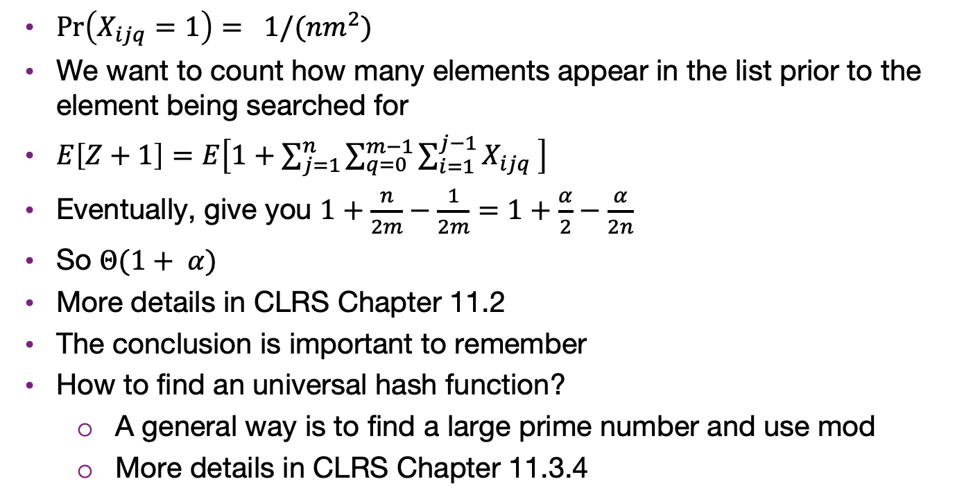
Analysis of separate chaining under universality
$\operatorname{Pr}\left(X_{ijq}=1\right)= 1/(nm^{2})$
We want to count how many elements appear in the list prior to the element being searched for
$E\left[Z+1\right]=E\left[1+\sum_{j=1}^{n}{\sum_{q=0}^{m−1}{\sum_{i=1}^{j−1}{X_{ijq}}}} \right]$
Eventually, give you $1+\frac{n}{2m}−\frac{1}{2m}=1+\frac{α}{2}−\frac{α}{2n}$
So $Θ(1+ α)$
More details in CLRS Chapter 11.2
The conclusion is important to remember
How to find an universal hash function?
  A general way is to find a large prime number and use mod
  More details in CLRS Chapter 11.3.4

Slide 22
Open addressing
Resolve the collision within the hash table (without using sperate linked lists)
Open addressing:
  relocate the key to be inserted if collision happens
  That is, we store K at an entry different from T(h(K))
Two issues arise
  What is the relocation scheme?
  How to search for K later?
Three common methods for resolving a collision in open addressing
  Linear probing
  Quadratic probing
  Double hashing

Slide 23
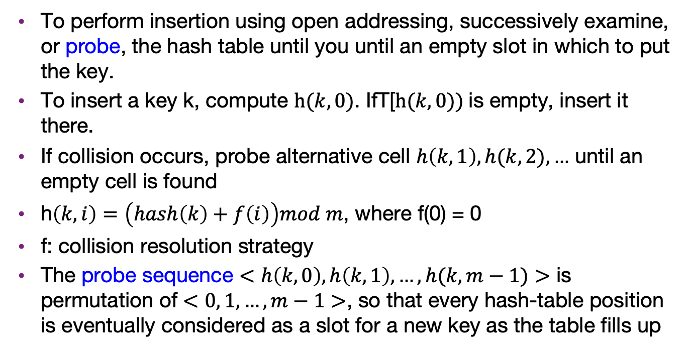
Open addressing resolution
To perform insertion using open addressing, successively examine, or probe, the hash table until you until an empty slot in which to put the key.
To insert a key k, compute $h(k, 0)$. IfT[$h(k, 0))$is empty, insert it there.
If collision occurs, probe alternative cell $h\left(k, 1\right),h(k, 2),…$ until an empty cell is found
h$\left(k, i\right)=\left(hash\left(k\right)+f\left(i\right)\right)mod m$, where f(0) = 0
f: collision resolution strategy
The probe sequence $<h\left(k, 0\right), h\left(k,1\right),…, h(k, m−1)>$ is permutation of $<0, 1,…, m−1>$, so that every hash-table position is eventually considered as a slot for a new key as the table fills up

Slide 24
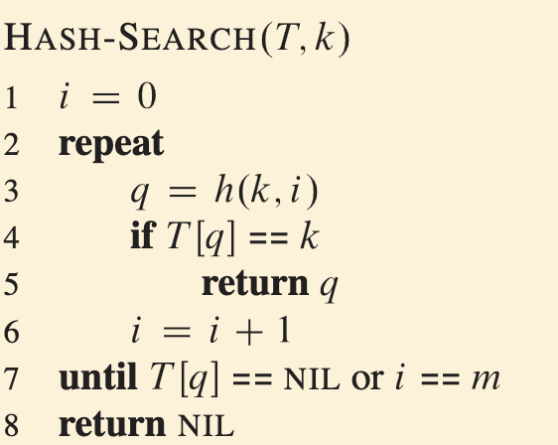
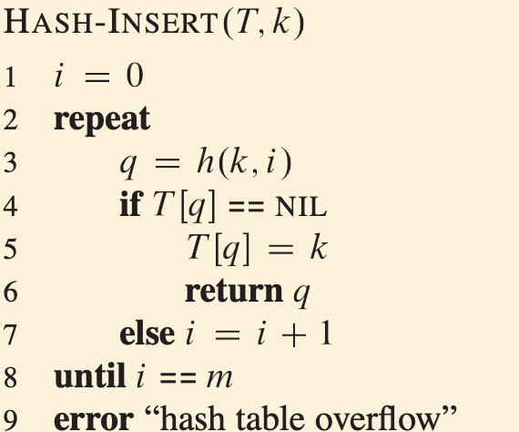
Open addressing
We can probe the slots sequentially for searching and insertion
Can we do the deletion in such way?
  No. A deletion in a sequence will isolates records further down the probe
  Easy solution: flag the deleted slot DELETED
    You can move up the later keys for linear probing, but not for general open addressing

Slide 25
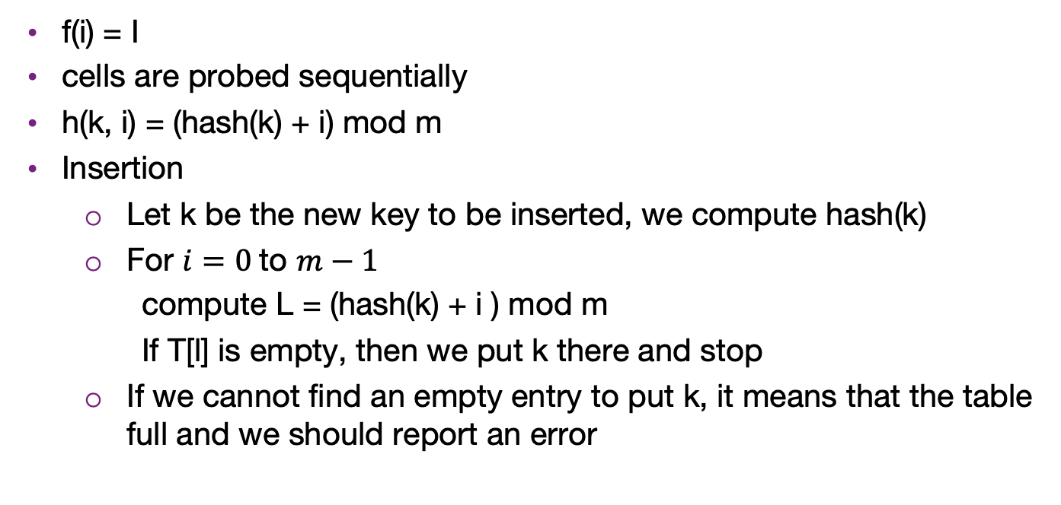
Linear probing
f(i) = I
cells are probed sequentially
h(k, i) = (hash(k) + i) mod m
Insertion
  Let k be the new key to be inserted, we compute hash(k)
  For $i=0$to $m−1$
    compute L = (hash(k) + i ) mod m
    If T[l] is empty, then we put k there and stop
  If we cannot find an empty entry to put k, it means that the table full and we should report an error

Slide 26
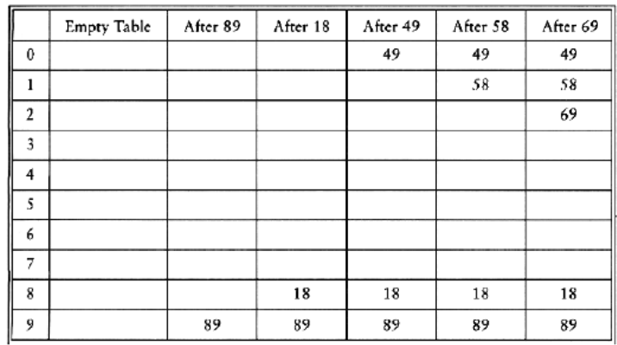
Linear probing example
h(k, i) = (hash(k) + i) mod m
inserting 89 18, 49,58, 69, with hash(k) = k and m = 10
  To insert 58, probe T[8], T[9], T[0], T[1]
  To insert 69, probe T[9], T[0], T[1], T[2]

Slide 27
Linear Probing
Consider a hash table with M = 16 bins
Given a 3-digit hexadecimal number:
  The least-significant digit is the primary hash function (bin)
  Example: for 6B72A₁₆ , the initial bin is A and the jump size is 3

Slide 28
Insertion
Insert these numbers into this initially empty hash table:
  19A, 207, 3AD, 488, 5BA, 680, 74C, 826, 946, ACD, B32, C8B, DBE, E9C
0 | 1 | 2 | 3 | 4 | 5 | 6 | 7 | 8 | 9 | A | B | C | D | E | F

Slide 29
Example
Start with the first four values:
  19A, 207, 3AD, 488
0 | 1 | 2 | 3 | 4 | 5 | 6 | 7 | 8 | 9 | A | B | C | D | E | F

Slide 30
Example
Start with the first four values:
  19A, 207, 3AD, 488
0 | 1 | 2 | 3 | 4 | 5 | 6 | 7 | 8 | 9 | A | B | C | D | E | F
 |  |  |  |  |  |  | 207 | 488 |  | 19A |  |  | 3AD

Slide 31
Example
Next we must insert 5BA
0 | 1 | 2 | 3 | 4 | 5 | 6 | 7 | 8 | 9 | A | B | C | D | E | F
 |  |  |  |  |  |  | 207 | 488 |  | 19A |  |  | 3AD

Slide 32
Example
Next we must insert 5BA
  Bin A is occupied
  We search forward for the next empty bin
0 | 1 | 2 | 3 | 4 | 5 | 6 | 7 | 8 | 9 | A | B | C | D | E | F
 |  |  |  |  |  |  | 207 | 488 |  | 19A | 5BA |  | 3AD

Slide 33
Example
Next we are adding 680, 74C, 826
0 | 1 | 2 | 3 | 4 | 5 | 6 | 7 | 8 | 9 | A | B | C | D | E | F
 |  |  |  |  |  |  | 207 | 488 |  | 19A | 5BA |  | 3AD

Slide 34
Example
Next we are adding 680, 74C, 826
  All the bins are empty—simply insert them
0 | 1 | 2 | 3 | 4 | 5 | 6 | 7 | 8 | 9 | A | B | C | D | E | F
680 |  |  |  |  |  | 826 | 207 | 488 |  | 19A | 5BA | 74C | 3AD

Slide 35
Example
Next, we must insert 946
0 | 1 | 2 | 3 | 4 | 5 | 6 | 7 | 8 | 9 | A | B | C | D | E | F
680 |  |  |  |  |  | 826 | 207 | 488 |  | 19A | 5BA | 74C | 3AD

Slide 36
Example
Next, we must insert 946
  Bin 6 is occupied
  The next empty bin is 9
0 | 1 | 2 | 3 | 4 | 5 | 6 | 7 | 8 | 9 | A | B | C | D | E | F
680 |  |  |  |  |  | 826 | 207 | 488 | 946 | 19A | 5BA | 74C | 3AD

Slide 37
Example
Next, we must insert ACD
0 | 1 | 2 | 3 | 4 | 5 | 6 | 7 | 8 | 9 | A | B | C | D | E | F
680 |  |  |  |  |  | 826 | 207 | 488 | 946 | 19A | 5BA | 74C | 3AD

Slide 38
Example
Next, we must insert ACD
  Bin D is occupied
  The next empty bin is E
0 | 1 | 2 | 3 | 4 | 5 | 6 | 7 | 8 | 9 | A | B | C | D | E | F
680 |  |  |  |  |  | 826 | 207 | 488 | 946 | 19A | 5BA | 74C | 3AD | ACD

Slide 39
Example
Next, we insert B32
0 | 1 | 2 | 3 | 4 | 5 | 6 | 7 | 8 | 9 | A | B | C | D | E | F
680 |  |  |  |  |  | 826 | 207 | 488 | 946 | 19A | 5BA | 74C | 3AD | ACD

Slide 40
Example
Next, we insert B32
  Bin 2 is unoccupied
0 | 1 | 2 | 3 | 4 | 5 | 6 | 7 | 8 | 9 | A | B | C | D | E | F
680 |  | B32 |  |  |  | 826 | 207 | 488 | 946 | 19A | 5BA | 74C | 3AD | ACD

Slide 41
Example
Next, we insert C8B
0 | 1 | 2 | 3 | 4 | 5 | 6 | 7 | 8 | 9 | A | B | C | D | E | F
680 |  | B32 |  |  |  | 826 | 207 | 488 | 946 | 19A | 5BA | 74C | 3AD | ACD

Slide 42
Example
Next, we insert C8B
  Bin B is occupied
  The next empty bin is F
0 | 1 | 2 | 3 | 4 | 5 | 6 | 7 | 8 | 9 | A | B | C | D | E | F
680 |  | B32 |  |  |  | 826 | 207 | 488 | 946 | 19A | 5BA | 74C | 3AD | ACD | C8B

Slide 43
Example
Next, we insert D59
0 | 1 | 2 | 3 | 4 | 5 | 6 | 7 | 8 | 9 | A | B | C | D | E | F
680 |  | B32 |  |  |  | 826 | 207 | 488 | 946 | 19A | 5BA | 74C | 3AD | ACD | C8B

Slide 44
Example
Next, we insert D59
  Bin 9 is occupied
  The next empty bin is 1
0 | 1 | 2 | 3 | 4 | 5 | 6 | 7 | 8 | 9 | A | B | C | D | E | F
680 | D59 | B32 |  |  |  | 826 | 207 | 488 | 946 | 19A | 5BA | 74C | 3AD | ACD | C8B

Slide 45
Example
Finally, insert E9C
0 | 1 | 2 | 3 | 4 | 5 | 6 | 7 | 8 | 9 | A | B | C | D | E | F
680 | D59 | B32 |  |  |  | 826 | 207 | 488 | 946 | 19A | 5BA | 74C | 3AD | ACD | C8B

Slide 46
Example
Finally, insert E9C
  Bin C is occupied
  The next empty bin is 3
0 | 1 | 2 | 3 | 4 | 5 | 6 | 7 | 8 | 9 | A | B | C | D | E | F
680 | D59 | B32 | E9C |  |  | 826 | 207 | 488 | 946 | 19A | 5BA | 74C | 3AD | ACD | C8B

Slide 47
Example
Having completed these insertions:
  The load factor is λ = 14/16 = 0.875
  The average number of probes is 38/14 ≈ 2.71
0 | 1 | 2 | 3 | 4 | 5 | 6 | 7 | 8 | 9 | A | B | C | D | E | F
680 | D59 | B32 | E93 |  |  | 826 | 207 | 488 | 946 | 19A | 5BA | 74C | 3AD | ACD | C8B

Slide 48
Resizing the array
To double the capacity of the array, each value must be rehashed
  680, B32, ACD, 5BA, 826, 207, 488, D59 may be immediately placed
    We use the least-significant five bits for the initial bin
0 | 1 | 2 | 3 | 4 | 5 | 6 | 7 | 8 | 9 | A | B | C | D | E | F | 10 | 11 | 12 | 13 | 14 | 15 | 16 | 17 | 18 | 19 | 1A | 1B | 1C | 1D | 1E | 1F
680 |  |  |  |  |  | 826 | 207 | 488 |  |  |  |  | ACD |  |  |  |  | B32 |  |  |  |  |  |  | D59 | 5BA

Slide 49
Resizing the array
To double the capacity of the array, each value must be rehashed
  19A resulted in a collision
0 | 1 | 2 | 3 | 4 | 5 | 6 | 7 | 8 | 9 | A | B | C | D | E | F | 10 | 11 | 12 | 13 | 14 | 15 | 16 | 17 | 18 | 19 | 1A | 1B | 1C | 1D | 1E | 1F
680 |  |  |  |  |  | 826 | 207 | 488 |  |  |  |  | ACD |  |  |  |  | B32 |  |  |  |  |  |  | D59 | 5BA | 19A

Slide 50
Resizing the array
To double the capacity of the array, each value must be rehashed
  946 resulted in a collision
0 | 1 | 2 | 3 | 4 | 5 | 6 | 7 | 8 | 9 | A | B | C | D | E | F | 10 | 11 | 12 | 13 | 14 | 15 | 16 | 17 | 18 | 19 | 1A | 1B | 1C | 1D | 1E | 1F
680 |  |  |  |  |  | 826 | 207 | 488 | 946 |  |  |  | ACD |  |  |  |  | B32 |  |  |  |  |  |  | D59 | 5BA | 19A

Slide 51
Resizing the array
To double the capacity of the array, each value must be rehashed
  74C fits into its bin
0 | 1 | 2 | 3 | 4 | 5 | 6 | 7 | 8 | 9 | A | B | C | D | E | F | 10 | 11 | 12 | 13 | 14 | 15 | 16 | 17 | 18 | 19 | 1A | 1B | 1C | 1D | 1E | 1F
680 |  |  |  |  |  | 826 | 207 | 488 | 946 |  |  | 74C | ACD |  |  |  | 946 | B32 |  |  |  |  |  |  | D59 | 5BA | 19A

Slide 52
Resizing the array
To double the capacity of the array, each value must be rehashed
  3AD resulted in a collision
0 | 1 | 2 | 3 | 4 | 5 | 6 | 7 | 8 | 9 | A | B | C | D | E | F | 10 | 11 | 12 | 13 | 14 | 15 | 16 | 17 | 18 | 19 | 1A | 1B | 1C | 1D | 1E | 1F
680 |  |  |  |  |  | 826 | 207 | 488 | 946 |  |  | 74C | ACD | 3AD |  |  | 946 | B32 |  |  |  |  |  |  | D59 | 5BA | 19A

Slide 53
Resizing the array
To double the capacity of the array, each value must be rehashed
  Both E9C and C8B fit without a collision
  The load factor is λ = 14/32 = 0.4375
  The average number of probes is 18/14 ≈ 1.29
0 | 1 | 2 | 3 | 4 | 5 | 6 | 7 | 8 | 9 | A | B | C | D | E | F | 10 | 11 | 12 | 13 | 14 | 15 | 16 | 17 | 18 | 19 | 1A | 1B | 1C | 1D | 1E | 1F
680 |  |  |  |  |  | 826 | 207 | 488 | 946 |  | C8B | 74C | ACD | 3AD |  |  | 946 | B32 |  |  |  |  |  |  | D59 | 5BA | 19A | E9C

Slide 54
Searching
Testing for membership is similar to insertions:
Start at the appropriate bin, and searching forward until
      The item is found,
      An empty bin is found, or
      We have traversed the entire array
The third case will only occur if the hash table is full (load factor of 1)
0 | 1 | 2 | 3 | 4 | 5 | 6 | 7 | 8 | 9 | A | B | C | D | E | F
680 | D59 | B32 | E93 |  |  | 826 | 207 | 488 | 946 | 19A | 5BA | 74C | 3AD | ACD | C8B

Slide 55
Searching
Searching for C8B
0 | 1 | 2 | 3 | 4 | 5 | 6 | 7 | 8 | 9 | A | B | C | D | E | F
680 | D59 | B32 | E93 |  |  | 826 | 207 | 488 | 946 | 19A | 5BA | 74C | 3AD | ACD | C8B

Slide 56
Searching
Searching for C8B
  Examine bins B, C, D, E, F
  The value is found in Bin F
0 | 1 | 2 | 3 | 4 | 5 | 6 | 7 | 8 | 9 | A | B | C | D | E | F
680 | D59 | B32 | E93 |  |  | 826 | 207 | 488 | 946 | 19A | 5BA | 74C | 3AD | ACD | C8B

Slide 57
Searching
Searching for 23E
0 | 1 | 2 | 3 | 4 | 5 | 6 | 7 | 8 | 9 | A | B | C | D | E | F
680 | D59 | B32 | E93 |  |  | 826 | 207 | 488 | 946 | 19A | 5BA | 74C | 3AD | ACD | C8B

Slide 58
Searching
Searching for 23E
  Search bins E, F, 0, 1, 2, 3, 4
  The last bin is empty; therefore, 23E is not in the table
0 | 1 | 2 | 3 | 4 | 5 | 6 | 7 | 8 | 9 | A | B | C | D | E | F
680 | D59 | B32 | E93 | × |  | 826 | 207 | 488 | 946 | 19A | 5BA | 74C | 3AD | ACD | C8B

Slide 59
Erasing
We cannot simply remove elements from the hash table
0 | 1 | 2 | 3 | 4 | 5 | 6 | 7 | 8 | 9 | A | B | C | D | E | F
680 | D59 | B32 | E93 |  |  | 826 | 207 | 488 | 946 | 19A | 5BA | 74C | 3AD | ACD | C8B

Slide 60
Erasing
We cannot simply remove elements from the hash table
  For example, consider erasing 3AD
0 | 1 | 2 | 3 | 4 | 5 | 6 | 7 | 8 | 9 | A | B | C | D | E | F
680 | D59 | B32 | E93 |  |  | 826 | 207 | 488 | 946 | 19A | 5BA | 74C | 3AD | ACD | C8B

Slide 61
Erasing
We cannot simply remove elements from the hash table
  For example, consider erasing 3AD
  If we just erase it, it is now an empty bin
    By our algorithm, we cannot find ACD, C8B and D59
0 | 1 | 2 | 3 | 4 | 5 | 6 | 7 | 8 | 9 | A | B | C | D | E | F
680 | D59 | B32 | E93 |  |  | 826 | 207 | 488 | 946 | 19A | 5BA | 74C |  | ACD | C8B

Slide 62
Erasing
Instead, we must attempt to fill the empty bin
0 | 1 | 2 | 3 | 4 | 5 | 6 | 7 | 8 | 9 | A | B | C | D | E | F
680 | D59 | B32 | E93 |  |  | 826 | 207 | 488 | 946 | 19A | 5BA | 74C |  | ACD | C8B

Slide 63
Erasing
Instead, we must attempt to fill the empty bin
  We can move ACD into the location
0 | 1 | 2 | 3 | 4 | 5 | 6 | 7 | 8 | 9 | A | B | C | D | E | F
680 | D59 | B32 | E93 |  |  | 826 | 207 | 488 | 946 | 19A | 5BA | 74C | ACD | ACD | C8B

Slide 64
Erasing
Now we have another bin to fill
0 | 1 | 2 | 3 | 4 | 5 | 6 | 7 | 8 | 9 | A | B | C | D | E | F
680 | D59 | B32 | E93 |  |  | 826 | 207 | 488 | 946 | 19A | 5BA | 74C | ACD |  | C8B

Slide 65
Erasing
Now we have another bin to fill
  We can move ACD into the location
0 | 1 | 2 | 3 | 4 | 5 | 6 | 7 | 8 | 9 | A | B | C | D | E | F
680 | D59 | B32 | E93 |  |  | 826 | 207 | 488 | 946 | 19A | 5BA | 74C | ACD | C8B | C8B

Slide 66
Erasing
Now we must attempt to fill the bin at F
  We cannot move 680
0 | 1 | 2 | 3 | 4 | 5 | 6 | 7 | 8 | 9 | A | B | C | D | E | F
680 | D59 | B32 | E93 |  |  | 826 | 207 | 488 | 946 | 19A | 5BA | 74C | ACD | C8B

Slide 67
Erasing
Now we must attempt to fill the bin at F
  We cannot move 680
  We can, however, move D59
0 | 1 | 2 | 3 | 4 | 5 | 6 | 7 | 8 | 9 | A | B | C | D | E | F
680 | D59 | B32 | E93 |  |  | 826 | 207 | 488 | 946 | 19A | 5BA | 74C | ACD | C8B | D59

Slide 68
Erasing
At this point, we cannot move B32 or E93 and the next bin is empty
  We are finished
0 | 1 | 2 | 3 | 4 | 5 | 6 | 7 | 8 | 9 | A | B | C | D | E | F
680 |  | B32 | E93 |  |  | 826 | 207 | 488 | 946 | 19A | 5BA | 74C | ACD | C8B | D59

Slide 69
Erasing
Suppose we delete 207
0 | 1 | 2 | 3 | 4 | 5 | 6 | 7 | 8 | 9 | A | B | C | D | E | F
680 |  | B32 | E93 |  |  | 826 | 207 | 488 | 946 | 19A | 5BA | 74C | ACD | C8B | D59

Slide 70
Erasing
Suppose we delete 207
  Cannot move 488
0 | 1 | 2 | 3 | 4 | 5 | 6 | 7 | 8 | 9 | A | B | C | D | E | F
680 |  | B32 | E93 |  |  | 826 |  | 488 | 946 | 19A | 5BA | 74C | ACD | C8B | D59

Slide 71
Erasing
Suppose we delete 207
  We could move 946 into Bin 7
0 | 1 | 2 | 3 | 4 | 5 | 6 | 7 | 8 | 9 | A | B | C | D | E | F
680 |  | B32 | E93 |  |  | 826 | 946 | 488 | 946 | 19A | 5BA | 74C | ACD | C8B | D59

Slide 72
Erasing
Suppose we delete 207
  We cannot move either the next five entries
0 | 1 | 2 | 3 | 4 | 5 | 6 | 7 | 8 | 9 | A | B | C | D | E | F
680 |  | B32 | E93 |  |  | 826 | 946 | 488 |  | 19A | 5BA | 74C | ACD | C8B | D59

Slide 73
Erasing
Suppose we delete 207
  We cannot move either the next five entries
0 | 1 | 2 | 3 | 4 | 5 | 6 | 7 | 8 | 9 | A | B | C | D | E | F
680 |  | B32 | E93 |  |  | 826 | 946 | 488 | D59 | 19A | 5BA | 74C | ACD | C8B | D59

Slide 74
Erasing
Suppose we delete 207
  We cannot fill this bin with 680, and the next bin is empty
  We are finished
0 | 1 | 2 | 3 | 4 | 5 | 6 | 7 | 8 | 9 | A | B | C | D | E | F
680 |  | B32 | E93 |  |  | 826 | 946 | 488 | D59 | 19A | 5BA | 74C | ACD | C8B

Slide 75
Primary Clustering
We have already observed the following phenomenon:
  With more insertions, the contiguous regions (or clusters) get larger
This results in longer search times
0 | 1 | 2 | 3 | 4 | 5 | 6 | 7 | 8 | 9 | A | B | C | D | E | F | 10 | 11 | 12 | 13 | 14 | 15 | 16 | 17 | 18 | 19 | 1A | 1B | 1C | 1D | 1E | 1F
680 |  |  |  |  |  | 826 | 207 | 488 | 946 |  | C8B | 74C | ACD | 3AD |  |  | 946 | B32 |  |  |  |  |  |  | D59 | 5BA | 19A | E9C

Slide 76
Primary Clustering
We currently have three clusters of length four
0 | 1 | 2 | 3 | 4 | 5 | 6 | 7 | 8 | 9 | A | B | C | D | E | F | 10 | 11 | 12 | 13 | 14 | 15 | 16 | 17 | 18 | 19 | 1A | 1B | 1C | 1D | 1E | 1F
680 |  |  |  |  |  | 826 | 207 | 488 | 946 |  | C8B | 74C | ACD | 3AD |  |  | 946 | B32 |  |  |  |  |  |  | D59 | 5BA | 19A | E9C

Slide 77
Primary Clustering
There is a 5/32 ≈ 16 % chance that an insertion will fill Bin A
0 | 1 | 2 | 3 | 4 | 5 | 6 | 7 | 8 | 9 | A | B | C | D | E | F | 10 | 11 | 12 | 13 | 14 | 15 | 16 | 17 | 18 | 19 | 1A | 1B | 1C | 1D | 1E | 1F
680 |  |  |  |  |  | 826 | 207 | 488 | 946 |  | C8B | 74C | ACD | 3AD |  |  | 946 | B32 |  |  |  |  |  |  | D59 | 5BA | 19A | E9C

Slide 78
Primary Clustering
There is a 5/32 ≈ 16 % chance that an insertion will fill Bin A
  This causes two clusters to coalesce into one larger cluster of length 9
0 | 1 | 2 | 3 | 4 | 5 | 6 | 7 | 8 | 9 | A | B | C | D | E | F | 10 | 11 | 12 | 13 | 14 | 15 | 16 | 17 | 18 | 19 | 1A | 1B | 1C | 1D | 1E | 1F
680 |  |  |  |  |  | 826 | 207 | 488 | 946 | 747 | C8B | 74C | ACD | 3AD |  |  | 946 | B32 |  |  |  |  |  |  | D59 | 5BA | 19A | E9C

Slide 79
Primary Clustering
There is now a 11/32 ≈ 34 % chance that the next insertion will increase the length of this cluster
0 | 1 | 2 | 3 | 4 | 5 | 6 | 7 | 8 | 9 | A | B | C | D | E | F | 10 | 11 | 12 | 13 | 14 | 15 | 16 | 17 | 18 | 19 | 1A | 1B | 1C | 1D | 1E | 1F
680 |  |  |  |  |  | 826 | 207 | 488 | 946 | 747 | C8B | 74C | ACD | 3AD |  |  | 946 | B32 |  |  |  |  |  |  | D59 | 5BA | 19A | E9C

Slide 80
Primary Clustering
As the cluster length increases, the probability of further increasing the length increases
In general:
  Suppose that a cluster is of length ℓ
  An insertion either into any bin occupied by the chain or into the locations immediately before or after it will increase the length of the chain
  This gives a probability of
0 | 1 | 2 | 3 | 4 | 5 | 6 | 7 | 8 | 9 | A | B | C | D | E | F | 10 | 11 | 12 | 13 | 14 | 15 | 16 | 17 | 18 | 19 | 1A | 1B | 1C | 1D | 1E | 1F
680 |  |  |  |  |  | 826 | 207 | 488 | 946 | 747 | C8B | 74C | ACD | 3AD |  |  | 946 | B32 |  |  |  |  |  |  | D59 | 5BA | 19A | E9C

Slide 81
Run-time analysis
The length of these chains will affect the number of probes required to perform insertions, accesses, or removals
It is possible to estimate the average number of probes for a successful search, where λ is the load factor:
For example: if λ = 0.5, we require 1.5 probes on average
Reference: Knuth, The Art of Computer Programming, Vol. 3, 2nd Ed., Addison Wesley, 1998, p.528.

Slide 82
Run-time analysis
The number of probes for an unsuccessful search or for an insertion is higher:
For 0 ≤ λ ≤ 1, then (1 – λ)² ≤ 1 – λ, and therefore the reciprocal will be larger
  Again, if λ = 0.5 then we require 2.5 probes on average
Reference: Knuth, The Art of Computer Programming, Vol. 3, 2nd Ed., Addison Wesley, 1998, p.528.

Slide 83
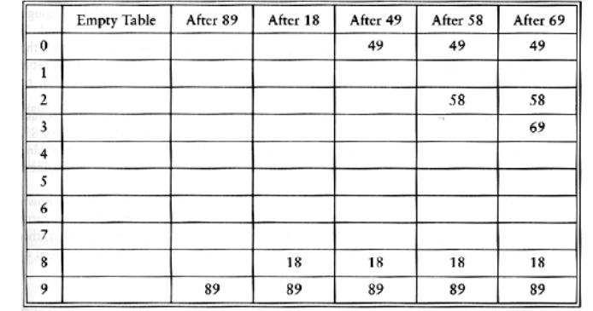

Quadratic probing
$f\left(i\right)=i^{2}$
$h\left(k, i\right)=(hash\left(k\right)+ i^{2})$
To insert 58, probe T[8], T[9], T[(8+4) mod 10]
To insert 69, probe T[9], T[(9+1) mod 10], T[(9+4) mod 10]

Slide 84
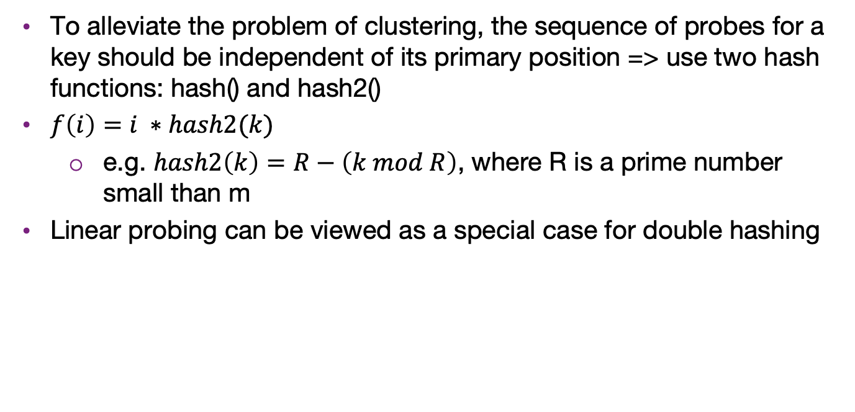
Double hashing
To alleviate the problem of clustering, the sequence of probes for a key should be independent of its primary position => use two hash functions: hash() and hash2()
$f\left(i\right)=i ∗hash2(k)$
  e.g. $hash2\left(k\right)=R−\left(k mod R\right)$, where R is a prime number small than m
Linear probing can be viewed as a special case for double hashing

Slide 85
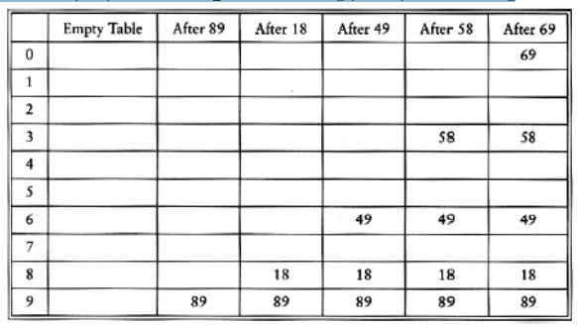
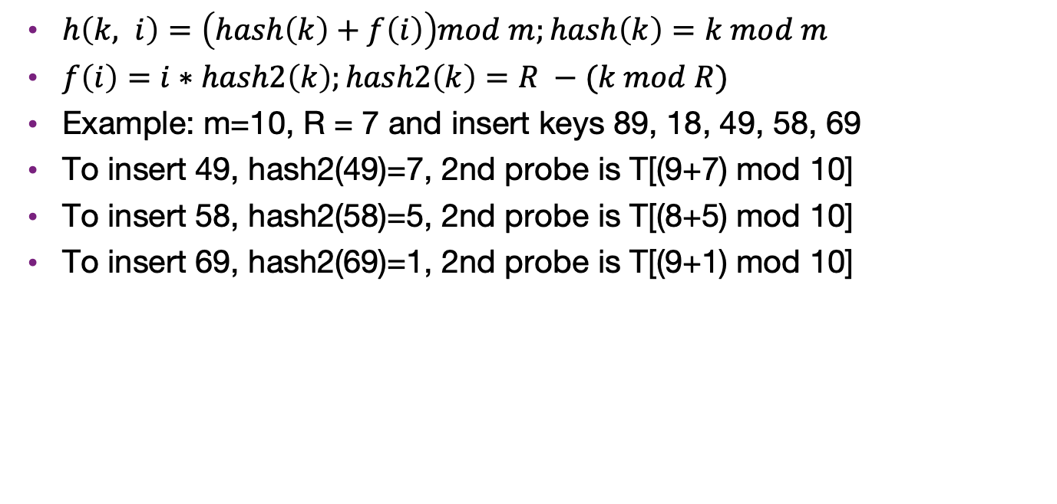
Double hashing
$h\left(k, i\right)=\left(hash\left(k\right)+f\left(i\right)\right)mod m;hash\left(k\right)=k mod m$
$f\left(i\right)=i∗hash2\left(k\right);hash2\left(k\right)=R −(k mod R)$
Example: m=10, R = 7 and insert keys 89, 18, 49, 58, 69
To insert 49, hash2(49)=7, 2nd probe is T[(9+7) mod 10]
To insert 58, hash2(58)=5, 2nd probe is T[(8+5) mod 10]
To insert 69, hash2(69)=1, 2nd probe is T[(9+1) mod 10]

Slide 86
Choice of hash2
Hash2() must never evaluate to zero
For any key K, hash2(K) must be relatively prime to the table size m. Otherwise, we will only be able to examine a fraction of the table entries.
  E.g., if hash(K) = 0 and hash2(K) = m/2, then we can only examine the entries T[0], T[m/2], and nothing else!
One solution is to make m prime, and choose R to be a prime smaller than m, and set hash2(K) = R - (K mod R)
Quadratic probing, however, does not require the use of a second hash function
  likely to be simpler and faster in practice

Slide 87
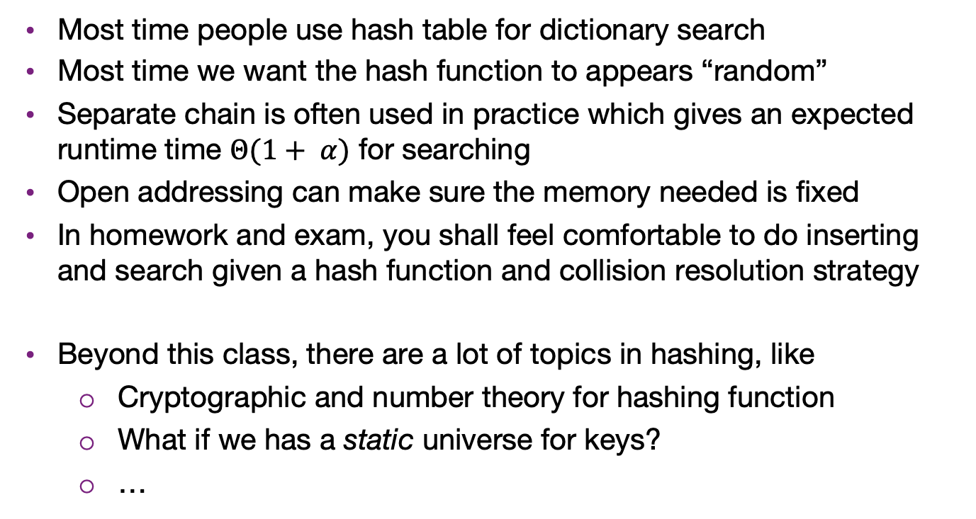
Summary
Most time people use hash table for dictionary search
Most time we want the hash function to appears “random”
Separate chain is often used in practice which gives an expected runtime time $Θ(1+ α)$ for searching
Open addressing can make sure the memory needed is fixed
In homework and exam, you shall feel comfortable to do inserting and search given a hash function and collision resolution strategy
Beyond this class, there are a lot of topics in hashing, like
  Cryptographic and number theory for hashing function
  What if we has a static universe for keys?
  …

